Slide 1

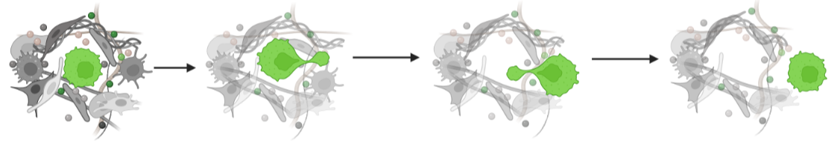


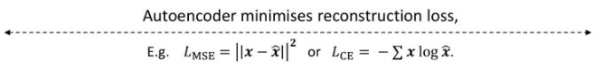
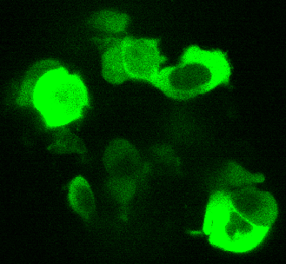
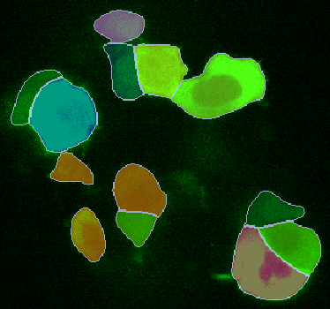
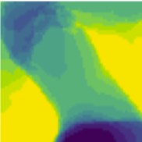

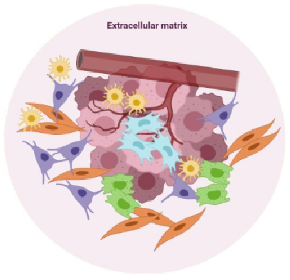
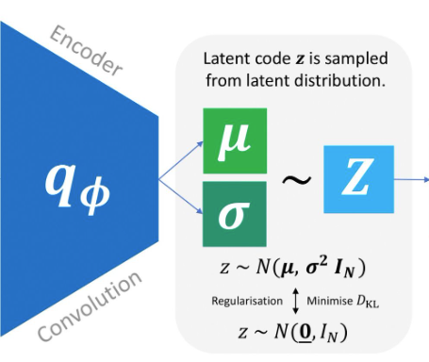
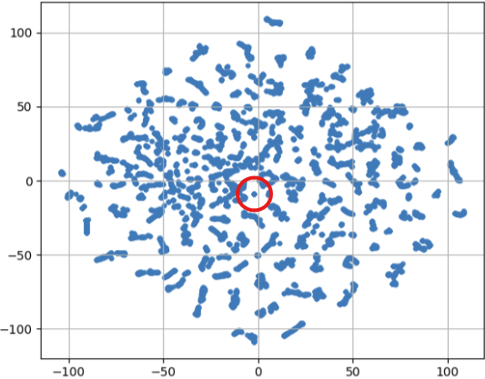







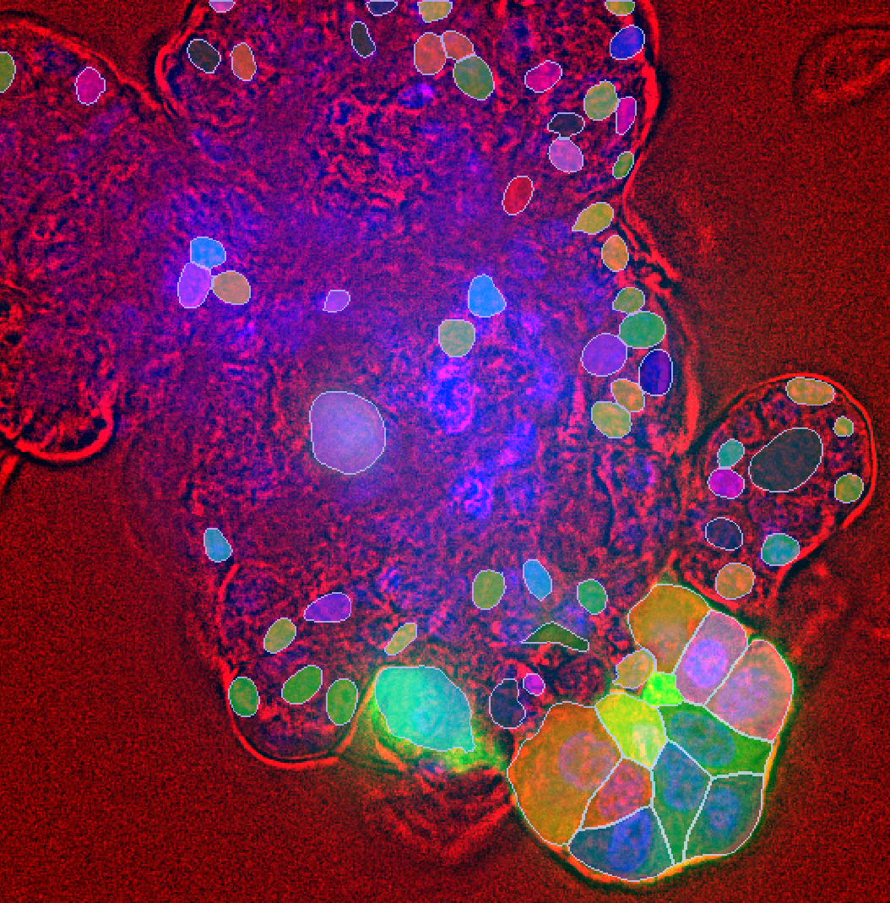
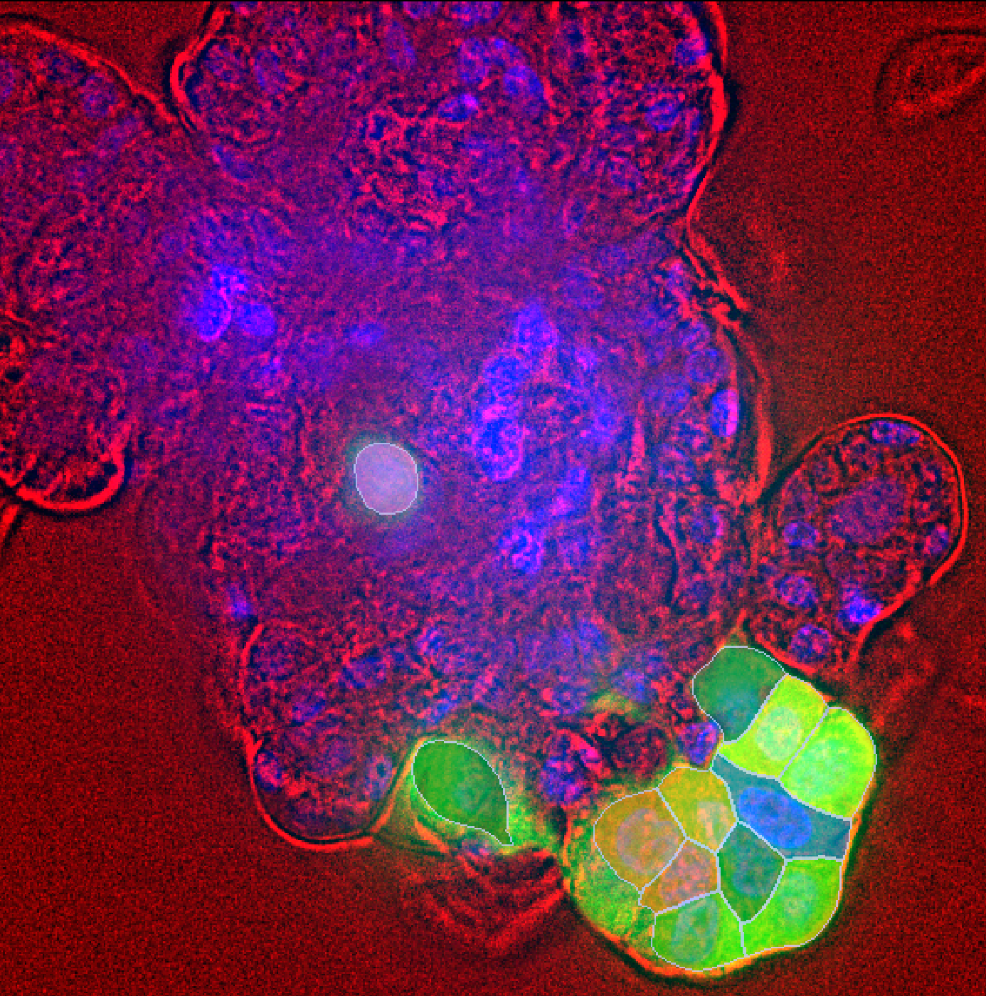


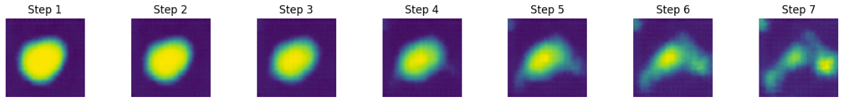
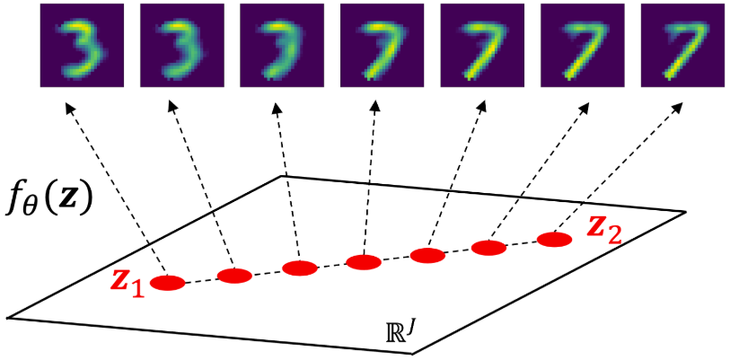
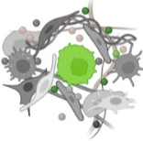
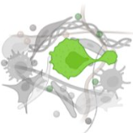

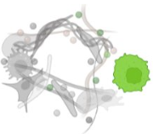
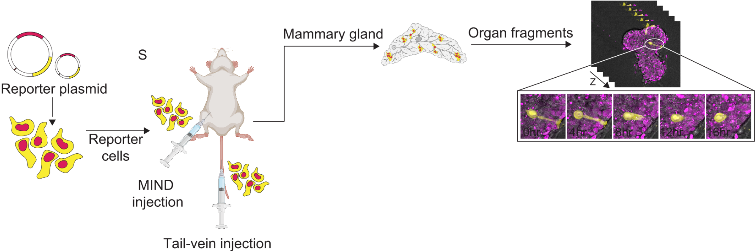
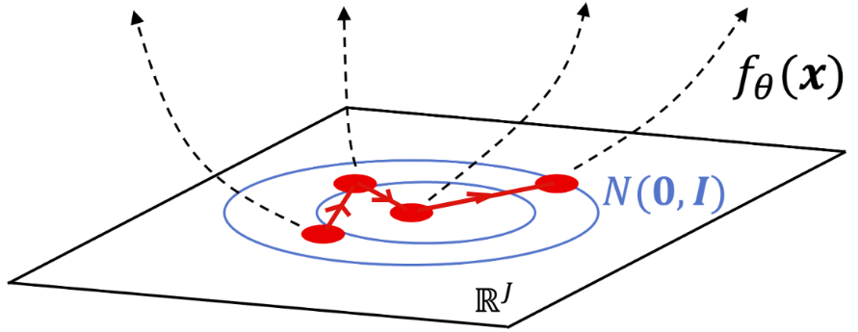
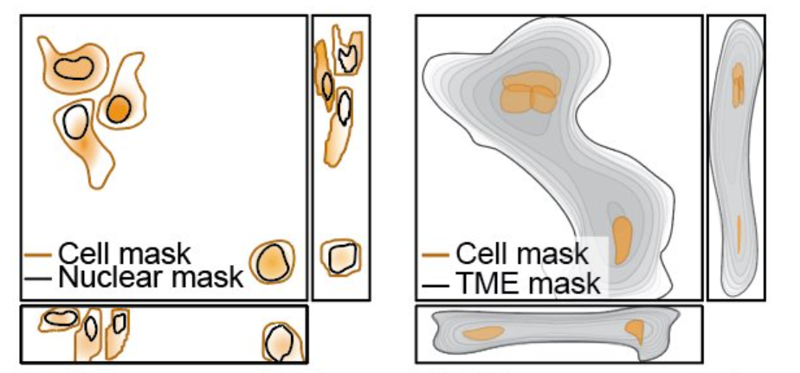
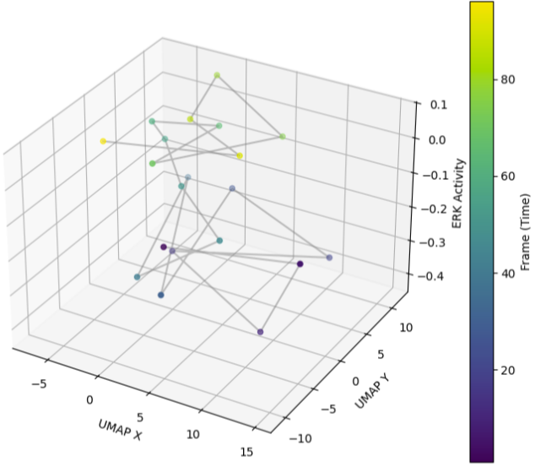
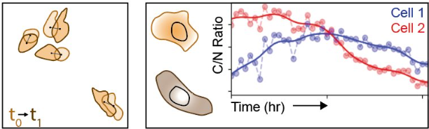
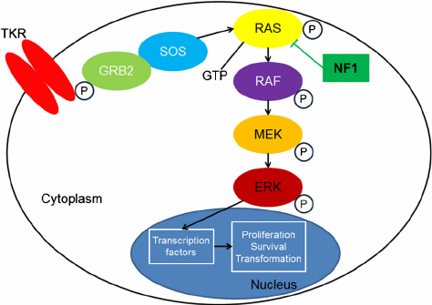

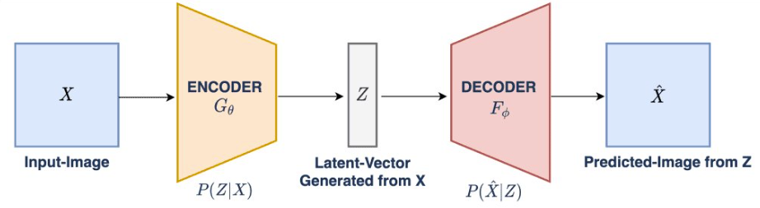

Learning the Language of Invasion:
A Deep Learning Framework for Cell-Cell Interaction and ERK Signaling in Breast Cancer
Qwynestria Petersen¹, Vaibhav Murthy¹, Jeremy Copperman¹, Alexander Davies^{1,2,3}
¹Cancer Early Detection Advance Research Center, Knight Cancer Institute, School of Medicine, Oregon Health and Science University, Portland, Oregon, USA
²Division of Oncological Sciences, Knight Cancer Institute, School of Medicine, Oregon Health & Science University, Portland, Oregon, USA
³Department of Pediatrics, School of Medicine, Oregon Health & Science University, Portland, Oregon, USA
OBJECTIVE
QUESTIONS
QUESTION
SEGMENTATION
What causes breast cancer cells to invade beyond the mammary gland?
Which patterns in 4D imaging (3D + time) link microenvironment interactions to ERK signaling?
To optimize cellular segmentation and explore the use of a
variational autoencoder (VAE) for modeling early-stage invasion dynamics.
VAE
Cellpose: software for segmenting cells in microscopy images.
Segmentation turns raw 3D images into biologically interpretable data.
Manual annotations significantly improve accuracy of tracking of cell movements and ERK signaling.
III. Using
Mammary gland cells
Cancer Cell Migration
VAE: Mapping invasion by encoding cellular information
Cyto
Cyto
Channel inputs:
Single cell images & masks
VAE Architecture
Channel Outputs
Original Image
Segmented Image
CHALLENGES
Host-cell
(5x64x64) dimensional input
Latent Space — t-SNE Projection
Host-cell
Tumor Microenvironment
Cancer-cells
Cancer-cells
Understanding cancer in 4D is hard.
    It's computationally expensive
    It's complex
    It's time consuming
    It's experimental
Bright-field
Figure 5. ERK signaling visualized with live-cell reporter and segmentation masks.
Bright-field
Cellpose's Model
Model w/ Manual Annotation
METHODS
Figure 1. Multi-channel input encoding into a 64-dimensional latent space using a convolutional VAE. Reconstructions are generated by decoding points from the latent space. Channels 1,2,3 are segmentation masks & Channels 4, 5 are images.
ERK-reporter
ERK-reporter
Our pipeline turns questions into answers.
Captures how cells interact in 4D using SITE.
Turns raw images into structured cellular data.
Maps cell movement and ERK signaling in cancer progression.
Detects invasion patterns with a variational autoencoder (VAE).
Cellular Image interpolations
A
B
SOLUTION
Invasion Trajectory
Serial Imaging of Tumor and microEnvironment Platform (SITE)
Figure 6. Segmentation models for ERK signaling in basal-like breast cancer cells.
IMPLICATIONS
Figure 2. Interpolation between two points in latent space, with reconstructed cancer-cell channel images illustrating a smooth transition between cell states.
Accurate cellular segmentation is critical for our pipeline, supporting reliable tracking, classification, and measurement, and provides the VAE with high-quality inputs to detect patterns linked to cell invasion.
VAEs show promise in modeling early-stage invasion by capturing subtle single-cell transitions in latent space. Still, further refinement is required to optimize this approach.
Cell & TME Segmentation
Single-Cell Trajectory & ERK Signaling
C
Figure 3. Visualization of latent space features associated with cancer cell invasion behavior.
Cell & Spatio-temporal Tracking
Interpolation: smooth transitions = meaningful features learned
Trajectories link cellular behavior to microenvironment cues (i.e. host tissue contact -> ERK signaling)
Latent space maps ERK activity to microenvironmental cues
ERK Signaling Pathway
RESOURCES
Variational Autoencoder (VAE)
Davies, A. E., Pargett, M., Siebert, S., Gillies, T. E., Choi, Y., Tobin, S. J., Ram, A. R., Murthy, V., Juliano, C., Quon, G., Bissell, M. J., & Albeck, J. G. (2020). Systems-level properties of EGFR-RAS-ERK signaling amplify local signals to generate dynamic gene expression heterogeneity. Cell Systems, 11(2), 85–100.e9. https://doi.org/10.1016/j.cels.2020.07.004
Murthy, V., Makkawi, R., Anderson, F., Halsey, C., Manalo-Hall, E., Srikanth, S., Tangkilisan, G., McGann, J., Copperman, J., & Davies, A. E. **(In preparation)**. Serial Imaging of Tumor and microEnvironment (SITE) platform for live-cell modeling of cancer progression dynamics. Oregon Health & Science University.
CEDAR
Figure 4. Temporal trajectory of a single cell in latent space, colored by ERK signaling intensity.

